Slide 1
Randomized Phase III Study Comparing Gefitinib With
Erlotinib in Patients With Previously Treated Advanced Lung
Adenocarcinoma: WJOG 5108L
Yoshiko U, et al. J Clin Oncol 34. 2016

Slide 2
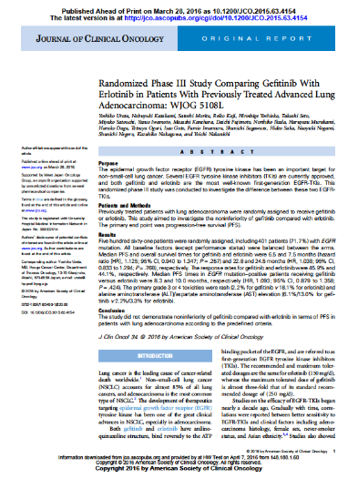
Key Finding
A comparison between gefitinib and erlotinib in a mixed, chemo-pretreated population of 561 patients (72% EGFRM+, 30% >3rd line, 23% recurrent NSCLC) for non-inferiority did not meet the pre-specified non-inferiority boundary for PFS.

Slide 3
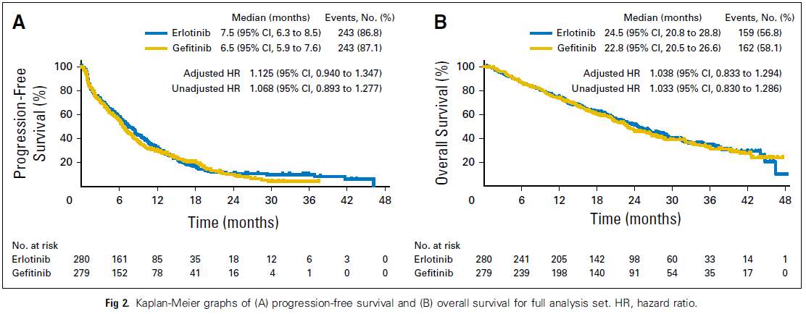
PFS and OS in FAS
FAS: full analysis set

Slide 4
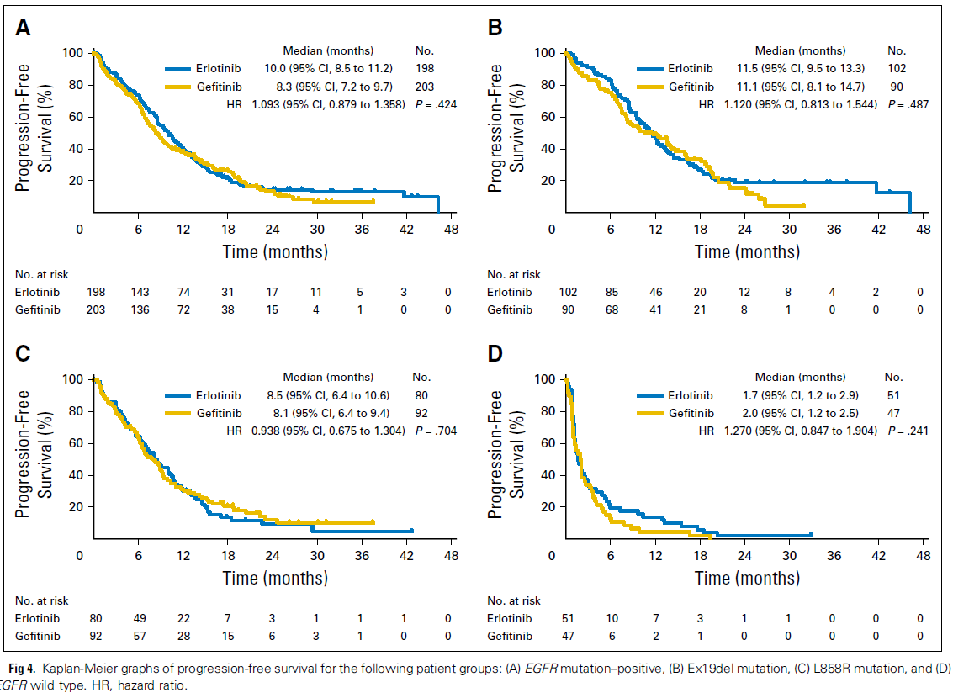
Subpopulation EGFRM+
EGFRM+
Del19
L858R
EGFR wt

Slide 5
Key Findings: Summary
 |  | Erlotinib | Gefitinib | HR (95% CI) | P-value
ORR | FAS | 44.1 % | 45.9 % |  | 0.686
 | EGFRM+ | 55.0 % | 58.9 % |  | 0.476
PFS | FAS | 7.5 mo | 6.5 mo | 1.125 (0.940, 1.347) | 0.257
 | EGFRM+ | 10.0 mo | 8.3 mo | 1.093 (0.879, 1.358) | 0.424
OS | FAS | 22.8 mo | 24.5 mo | 1.038 (0.833; 1.294) | 0.768
 | EGFRM+ | 31.4 mo | 26.5 mo | 1.189 (0.900, 1.570) | 0.221
FAS: full analysis set

Slide 6
Putting Into Perspective
This a Japanese-only Non-inferiority trial in a pre-treated mixed population including EGFR-wt as well as EGFRM+ patients.
The trial was (only after adjustment) not able to show non-inferiority of gefitinib for PFS according to the pre-specified boundary of 1.3 for upper CI.
However, efficacy parameter of erlotinib and gefitinib are not different (look at the curves!) with HRs around 1.1 and ORR numerically slightly better for gefitinib.

Slide 7
Is This Trial Relevant for LUX-Lung 7?
No, as this trial does not show superiority of erlotinib over gefitinib and it was performed in a different setting. EGRFM+ is a subgroup analysis (and also not showing superiority).
Efficacy parameter of erlotinib and gefitinib are not different (look at the curves!) with HRs around 1.1 showing that we didn‘t selected the ‚weaker‘ comparator.
  A recent H2H trial from China addressing superiority of erlotinib over gefitinib in EGFRM+ failed (CTONG 0901, presented at WCLC 2015 Denver).

Slide 8
Statistical Comments
Non-inferiority is not shown, but conclusion that Gefitinib is inferior is not valid. In particular, KM curves for PFS cross and p-values for difference in PFS are rather large
KM curves for PFS cross, PFS rates at 12 months are identical and KM curve of Gefitinib even above the KM curve for Erlotinib e.g. at 18 months. So no sign that one of the treatments is better than the other.
As KM curves cross, the proportional hazards assumption is questionable and the HR, as it is calculated under the assumption of PH, is not a good measure to describe treatment difference and also the adjusted HR via the Cox model could have caused problems.
Although the adjusted HR does not show non-inferiority, the unadjusted HR shows non-inferiority. Usually, one would not expect in a randomized trial a large effect on the point estimate by adjusting for variables already balanced at baseline due to the randomization.
The HR in the EGFR mutation-positive subgroup is closer to 1 with p-value of 0.424 for test of differences in PFS, but sample size is too small to show non-inferiority. KM curves also cross and e.g. PFS rate at 18 months is higher for Gefitinib. As before, HR is not a good measure to describe the difference in that setting.

