Slide 1
Influence of Dose Adjustment on Afatinib Safety and Efficacy in Patients with Advanced EGFR Mutation-positive NSCLC

Slide 2
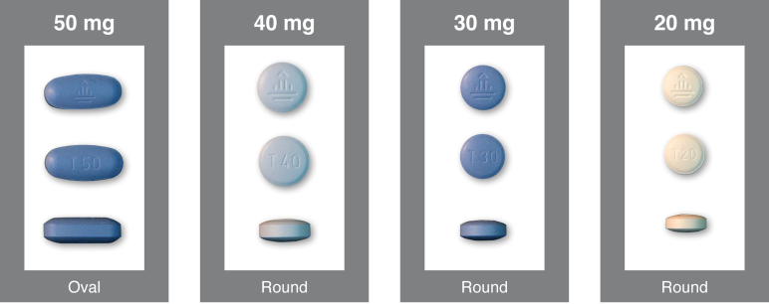
Afatinib Dosing and Administration
Standard dosing: 40 mg once daily
Administration: orally (film-coated tablets)

Slide 3
Dose Modification Scheme for Afatinib in the Protocol
Continue with 50 mg/d Dose
Absence of drug-related events >CTCAE grade 1 within first 3 weeks of treatment
Standard Dose of 40 mg/d
Grade ≥3 adverse events
Prolonged grade 2 (≥7 consecutive days)
Diarrhoea grade 2 >48 hours despite optimal care
Worsening of renal function grade 2
PAUSE until recovery to grade ≤1 or baseline
Resume treatment at dose REDUCED by 10 mg
Giotrif SmPC

Slide 4
Influence of Dose Adjustment on Afatinib Safety and Efficacy - Post-hoc Analyses of LUX-Lung 3
All patients treated with afatinib in LUX-Lung 3 were included in the analyses
For patients who had afatinib dose reductions, frequency and severity of the most common AEs pre- and post-dose reduction from 40 mg were analyzed
PK data collected at Day 22 and as part of the final standard visit schedule (Day 43) were used to compare plasma afatinib concentrations in patients who reduced to 30 mg versus those remaining at 40 mg
PFS (at time of primary PFS analysis) was compared between patients who dose reduced within the first 6 months of treatment and those who remained on afatinib 40 mg once daily A cut-off of 6 months was used as most dose reductions occur during this time
Yang J et al. J Clin Oncol 33, 2015 (suppl; abstr 8073)

Slide 5
Patient Characteristics at Baseline
Characteristic | Dose reduced to <40 mg at any time (n=122) | Dose at ≥40 mg throughout (n=107)
Gender Male Female | 31 (25.4) 91 (74.6) | 51 (47.7) 56 (52.3)
Age <65 years ≥65 years | 65 (53.3) 57 (46.7) | 74 (69.2) 33 (30.8)
Race Caucasian Eastern Asian Other Other Asian | 23 (18.9) 98 (80.3) 1 (0.8) 0 (0.0) | 38 (35.5) 66 (61.7) 2 (1.9) 1 (0.9)
Smoking status Never smoked Ex-smoker Currently smokes | 87 (71.3) 34 (27.9) 1 (0.8) | 67 (62.6) 36 (33.6) 4 (3.7)
Weight category <50 kg ≥50 kg | 31 (25.4) 91 (74.6) | 14 (13.1) 93 (86.9)
ECOG PS 0 1 | 48 (39.3) 74 (60.7) | 44 (41.1) 63 (58.9)
53% patients treated with afatinib reduced dose
86% dose reductions occurred within the first 6 months of treatment
Dose reductions tended to be more common in:
  female patients,
  older patients,
  patients of Eastern Asian ethnicity and
  patients with lower body weight
Data are n (%)
Yang J et al. J Clin Oncol 33, 2015 (suppl; abstr 8073)

Slide 6
Key Treatment-related AEs in Patients Requiring Tolerability-guided Dose Modification
Median treatment exposure for dose-reduced patients:
  48.5 days on 40 mg (n=122),
  140 days on 30 mg (n=120),
  276.5 days on 20 mg (n=40)
Any
Diarrhea
Rash/acne
Stomatitis
Nail effects
Pre: AEs before dose reduction from 40 mg; post: AEs after first dose reduction from 40 mg
Despite longer treatment exposure at lower doses, tolerability-guided dose reduction led to decreases in the incidence and severity of treatment-related AEs.
Yang J et al. J Clin Oncol 33, 2015 (suppl; abstr 8073)

Slide 7
Afatinib Plasma Levels in Patients Who Dose Reduced and Those Who Remained on Afatinib 40 mg
Individual data with median
and 25th/75th percentiles
10th/90th percentiles
Datapoints outside
percentiles
Dose reduction was more likely in patients with higher plasma concentrations
Geometric mean plasma concentrations
  24.4 ng/mL after dose reduction to 30 mg ≥4 days previously (n=38)
  23.7 ng/mL in patients who remained on 40 mg (n=126)
140
120
100
80
Trough plasma concentrations (ng/mL)
60
40
20
0
40 mg
(n=122)
40 mg
(n=10)
40 mg
(n=126)
30 mg
(n=38)
C2V1 (Day 22)
C3V1 (Day 43)
: patients who remained on 40 mg until C3V1 (n=126); , patients who dose reduced to 30 mg before C3V1 (n=38; only 10 of these patients had valid trough concentrations on 40 mg afatinib at C2V1 [the rest had either no PK sampling due to dose interruption, were already on 30 mg afatinib or were excluded due to invalid sampling])
Yang J et al. J Clin Oncol 33, 2015 (suppl; abstr 8073)

Slide 8
PFS in Patients Who Had or Had Not Dose Reductions Within the First 6 Months
<40 mg in first 6 months
 | <40 mg in first 6 months (n=105) | ≥40 mg for first 6 months (n=124)
Median PFS (mo) | 11.3 | 11.0
HR (95% CI) P-value | 1.25 (0.91–1.72) 0.175
≥40 mg in first 6 months
PFS in overall population
1.0
0.8
0.6
Estimated PFS probability
0.4
0.2
0
0
3
6
9
12
15
18
21
24
27
Time (months)
No. at risk
<40 mg in first 6 months
105
87
75
58
41
26
15
6
2
0
≥40 mg for first 6 months
124
93
76
62
36
24
16
4
1
0
Median PFS was similar in patients who had afatinib dose reductions in the first 6 months and those who remained on afatinib 40 mg once daily
CI, confidence interval; HR, hazard ratio
Yang J et al. J Clin Oncol 33, 2015 (suppl; abstr 8073)

Slide 9
Subgroup Analyses of Treatment Duration and Afatinib Dose Level in Japanese Patients
Reason for reduction
Diarrhoea
Rash/acne
Diarrhoea and rash/acne
40 mg days
30 mg days
20 mg days
Time (days)
Kato et al. Cancer Sci. 2015;106(9):1202-11.

Slide 10
Conclusions
Tolerability-guided dose adjustment of afatinib seems to be an effective measure to reduce treatment-related AEs without affecting therapeutic efficacy
Incidence and severity of treatment-related AEs was lower following dose reduction
Tolerability-guided dose modification reduced the interpatient variability of afatinib exposure, while maintaining efficacious plasma levels
Efficacy outcomes were similar in patients who dose reduced due to AEs versus those who did not. Similar was observed in Japanese patients

